Slide 1


Imitation Learning over Heterogeneous Agents with Restraining Bolts
Department of Computer, Control and Management Engineering
Students | ARCINIEGAS, Andrés (1874069)
 | MAKINWA, Sayo (1858908)
 | OREL, Egor (1836231)
 | RUIZ, David (1922212)
Professor | DE GIACOMO, Giuseppe, PhD.
(De Giacomo et all, 2020)

Slide 2

TABLE OF CONTENTS
Introduction
01
Problem Definition
02
Solution method
03
Case Studies
04
Intro, IRL, IL, DFA,
Restraining Bolt(RB)
RB structure, RB DFA training, Learning agent, Expert agent
Traces generalization,
DFA extraction, L* algorithm
Breakout, Sapientino, Minecraft Pong (additional)

Slide 3


PROBLEM DESCRIPTION
A common problem in Reinforcement Learning (RL) is that the reward function is hard to express.
How to overcome?
Inverse Reinforcement Learning (IRL)
a set of execution traces
(expert agent)
a reward function
learn the expert’s behavior
(learning agent)
Imitation Learning (IL)

Slide 4
PROBLEM DESCRIPTION
Typical IRL solutions
IL method
rely on a numerical representation of the reward function
a logical (≠numerical) specification of the reward function
The RB can be attached to the learning agent to drive the learning process and ultimately make it imitate the expert.
Incorporated into a Restraining Bolt (RB)
No need of optimization procedures;
Can be applied to heterogeneous agents, with the expert, the learner and the RB using different representations of the environment’s actions and states, without specifying mappings among their representations.
Problems related to the adopted optimization procedures;
Must share the representation state (i.e. states and actions)

Slide 5


RESTRAINING BOLT
RB is a device, with its own sensors, that can be attached to a Reinforcement Learning (RL) agent, to constrain its behavior and make it fulfill desired temporal high-level goals.
High-level goals are expressed as formulas of linear-time temporal logic over finite traces, LDL_{f}, over a set of fluents, generally different from the features used by the RL agent.

Slide 6
RESTRAINING BOLT
LEARNER A
RB
EXPERT
high-level traces
low-level traces
LEARNER B
In other words, the low-level traces generated by the expert are transformed into high-level traces from the RB sensors. Once the high-level behavior is learned, this can be transferred to an agent with different capabilities.
This process can be seen as IRL at the RB representation level: instead of estimating the reward function, we reconstruct the DFA associated with the goal formula and then use it for learning.

Slide 7
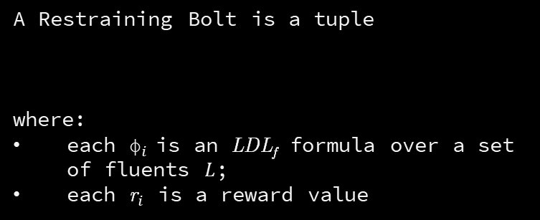


RESTRAINING BOLT
A Restraining Bolt is a tuple
where:
each ${\text{ϕ}}_{i}$is an LDL_{f} formula over a set of fluents $L$;
each ${\text{r}}_{i}$ is a reward value
$$\text{RB}\text{=}\left\langle \text{L}\text{, }{\text{\{}{\text{ϕ}}_{\text{i}}\text{,}{\text{r}}_{\text{i}}\text{\}}}_{\text{i}\text{=1}}^{\text{m}}\right\rangle$$
Formulas ${\text{ϕ}}_{i}$ specify the behaviors that should be rewarded, each with its respective ${\text{r}}_{i}$.

Slide 8
IMITATION LEARNING
Use Restraining Bolt
Learn Restraining Bolt
fluents
Learning Restraining Bolt
(DFA learner)
fluents
Restraining Bolt
(DFA + rewards)
teacher rewards
T-rewards
features
Teacher
action
features
action
Learning Agent
rewards from
environment
T-features
Extractor
T-action
actuator
Rewards
extractor
Environment
Fluents
Extractor
Fluents
extractor
Environment
T-action
actuator
T-features
extractor

Slide 9

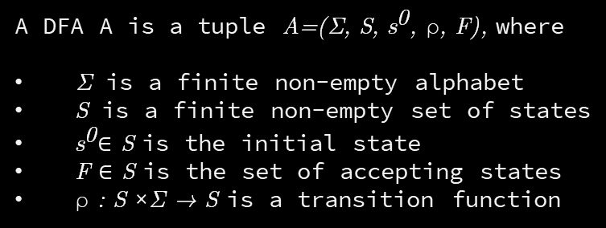



DFA
Deterministic Finite Automata
A DFA A is a tuple $\text{A}\text{=(}\text{Σ}\text{, }\text{S}\text{, }{\text{s}}^{\text{0}}\text{, }\text{ρ}\text{, }\text{F}\text{)}$, where
$\text{Σ}$ is a finite non-empty alphabet
$\text{S}$ is a finite non-empty set of states
${\text{s}}^{\text{0}}\text{∈ }\text{S}$ is the initial state
$\text{F}\text{ ∈ }\text{S}$ is the set of accepting states
$\text{ρ}\text{ : }\text{S} \text{×}\text{Σ}\text{ → }\text{S}$ is a transition function
0
1
0
An automaton is essentially an edge-labelled directed graph:
States → Nodes
Transitions → Edges
1
$$S_{0}$$
$$S_{1}$$
$$S_{2}$$
0
0

Slide 10
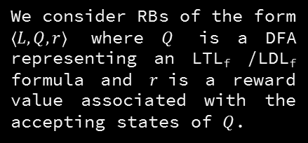
RB DFA training
DFA = Deterministic Finite-state Automaton
negative (undesired) traces
Consider a setting where the expert agent executes its policy, producing desired and undesired traces at its own representation level.
The resulting DFA represents (an approximation of) the expert’s behavior.
positive (desired) traces
We consider RBs of the form $\left\langle L, Q,r\right\rangle$ where $Q$ is a DFA representing an LTL_{f} /LDL_{f} formula and $r$is a reward value associated with the accepting states of $Q$.
Based on a well-known equivalence between LDL_{f} and DFAs, the DFA is incorporated into a RB attached to the RL agent, to make it learn a (possibly optimal) policy that imitates the expert’s behavior.

Slide 11

EXPERT AGENT
Consider an expert agent defined on a MDP:
$${\text{M}}_{\text{e}}\text{=⟨}{\text{S}}_{\text{e}}\text{,}{\text{A}}_{\text{e}}\text{,}{\text{T}\text{r}}_{\text{e}}\text{,}{\text{R}}_{\text{e}}\text{⟩}$$
This agent knows how to act according to a policy, but cannot describe its rewards. The expert can correctly classify the traces as positive or negative, based on its own state representation.
Also, traces can be seen from RB perspective (RB sensors), so from each state fluents can be extracted to produce the corresponding representation in the RB space.
The expert does not know anything about fluents, in particular, it cannot interpret them, as belonging to a different representation space. In fact, the expert is not even aware of the RB.

Slide 12


LEARNING AGENT
Consider a learning agent defined on a MDP:
$${\text{M}}_{\text{l}}\text{=⟨}{\text{S}}_{\text{l}}\text{,}{\text{A}}_{\text{l}}\text{,}{\text{Tr}}_{\text{l}}\text{,}{\text{R}}_{\text{l}}\text{⟩}$$
${Tr}_{l},R_{l}$ are unknown.
$S_{l},A_{l}$ and $S_{e},A_{e}$ respectively may be completely different, at least, without any explicit mapping between them.
The learning agent is also equipped with the RB that encodes the behavior of the expert agent in performing the given task.
The system $M_{l}^{RB}$ can be used to learn an optimal policy driven by RB:
$${\text{M}}_{\text{l}}^{\text{RB}}\text{=⟨}{\text{M}}_{\text{l}}\text{,}\text{RB}\text{⟩}$$
In this way, the behavior of the learner agent imitates that of the expert, when considering the evolution at the RB level.

Slide 13
SOLUTION METHOD
The core problem: extracting the DFA (or the formula) from the set T of (positive and negative) traces.
Notice that the target DFA is unknown, even to the expert. As a result, the best we can hope for is to come up with a good approximation. For this reason, we search for a DFA that accepts all positive and no negative traces, according to T.

Slide 14
GENERALIZATION OF TRACES
The best generalization of DFA over traces T:
accepts more traces than exactly the positive ones;
possibly reject more than the negative ones;
+ some bias.
One reasonable approach is to check smaller DFAs (in terms of number of states) first:
smaller DFAs are less selective;
tends to accept more traces than those with a large number of states.

Slide 15
EXTRACTING DFA
Several approaches exist for extracting a DFA from a set of labelled traces. In our case, any is a reasonable candidate. For simplicity, we have selected L*(Angluin 1987).
Why:
Firstly, the algorithm returns a DFA (not a formula) that can be used as-is when executing the RB.
Secondly, the algorithm produces increasingly larger DFAs, thus satisfying the generalization requirement discussed above – though it is not guaranteed to return the minimal DFA.

Slide 16

L* ALGORITHM
EXPERT
LEARNER
LEARNER
answers: “yes”, “no”, “yes/no”
uses membership queries to produce a candidate DFA
LEARNER TO EXPERT
membership query (“is this a positive trace?”) and equivalence query (“is this the target formula/automaton?”)
“Is this DFA a target one?”
Create a counterexample
“no”
“yes”
The algorithm is shown to terminate and find the target DFA in polynomial time wrt both the size of the minimal DFA equivalent to the target DFA and the maximum length of any returned counterexample
DFA is ready

Slide 17
L*
In our case, the expert executes the policy offline, so it can’t check and answer, can’t know whether the resulting DFA is target.
Also, an expert can’t be an oracle and answer to all questions of the L*. But having a set of traces T executed by the expert learner the “oracle” can be simulated such that L* creates an approximation of the suitable DFA.
ALGORITHM
How is it done:
Learner poses a membership query;
Simulated “oracle”:
“no” if T_{i} is negative;
“yes” if T_{i} is positive;
Learner: equivalence check is positive if the candidate DFA accepts all positive and no negative traces from T.

Slide 18


Case studies
Notes:
fwefwef

Slide 19

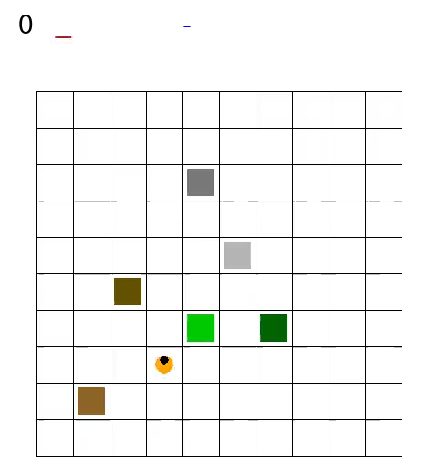

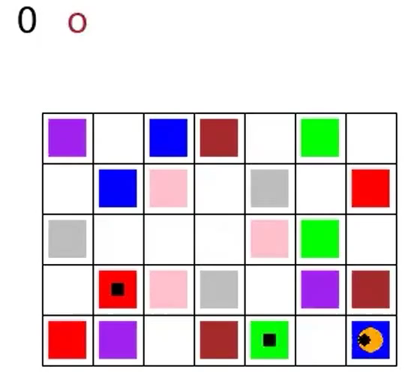
CASE STUDIES
MINECRAFT
BREAKOUT
SAPIENTINO
PONG
Notes:
For restraining

Slide 20



EXPERT
LEARNER
Case study:
Breakout
Target task:
All bricks must be removed, completing the columns from left to right.
Uses FIRE.
Simple (easier)
environment
Uses BALL.
More complex
environment
Notes:
Expert and Learner have a different mapping representation.

Slide 21


Breakout
TRUE AUTOMATON
EXTRACTED AUTOMATON
From LDLf Formula
(BY THE EXPERT)
Notes:
For time constrains, we will address only the case of Breakout, and our additional example

Slide 22
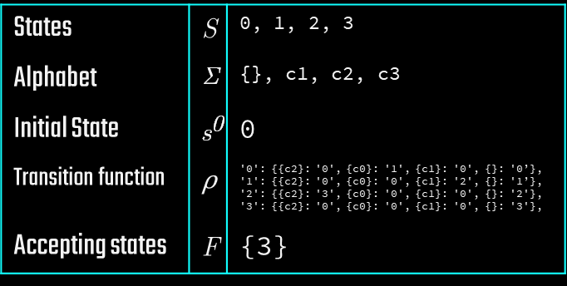
States | $$\text{S}$$ | 0, 1, 2, 3
Alphabet | $$\text{Σ}$$ | {}, c1, c2, c3
Initial State | $${\text{s}}^{\text{0}}$$ | 0
Transition function | $$\text{ρ}$$ | '0': {{c2}: '0', {c0}: '1', {c1}: '0', {}: '0’}, '1': {{c2}: '0', {c0}: '0', {c1}: '2', {}: '1’}, '2': {{c2}: '3', {c0}: '0', {c1}: '0', {}: '2'}, '3': {{c2}: '0', {c0}: '0', {c1}: '0', {}: '3'},
Accepting states | F | {3}
TRACES (samples)
POSITIVE
TRACES
c0;c1;c2
c0;c1;c2
c0;c1;c2
c0;c1;c2
c0;c1;c2
c0;c1;c2
c0;c1;c2
c0;c1;c2
c0;c1;c2
c0;c1;c2
c0;c1;c2
c0;c1;c2
c0;c1;c2
c0;c1;c2
c0;c1;c2
c0;c1;c2
NEGATIVE
TRACES
c1;c0;c2
c1;c2
c1;c2
c0;c2;c1
c2;c1
c1;c2;c0
c2;c1
c1;c2;c0
c2;c1;c0
c2;c1
c1;c0
c1;c0
c0;c2;c1
c2;c1;c0
c2;c1;c0
c2;c0
DFA
EXTRACTION
input to
Learner

Slide 23
Learner training with RB from generated DFA
True DFA - Goal
Expert training Generates DFA from traces
Breakout
No direct relation from the Original Goal definition and the final learner
Generated from the LDL formula, and describes the goal of the task.
Expert and Learner are trained with value-based RL techniques such as Q-Learning and SARSA

Slide 24
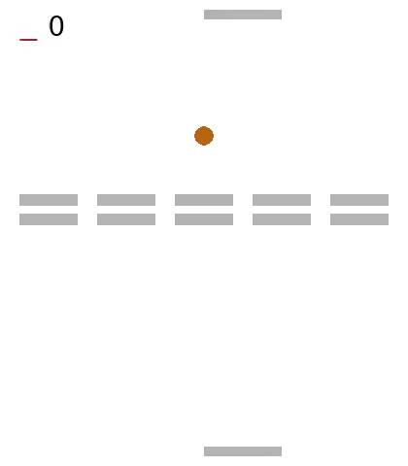
Case study: Breakout-Pong
Goal remains the same:
eliminate all the bricks.
Addition of a paddle on the top
that must play as well. Moves just as the bottom one.
Base for competitive Pong game.

Slide 25


Case study: Pong
(with bricks)
LEARNER 2
LEARNER 1
EXPERT
Notes:
We tried different variants

Slide 26


Generated DFA in 5-columns Breakout-Pong

Slide 27



Additional variants:
Side change
Pong 4 columns:
Breakout-pong
4 columns:
(in goal)

Slide 28
Conclusions
It is an approach based on the use of Restraining Bolts to perform Imitation Learning, with heterogeneous agents.
It makes use of Inverse Reinforcement Learning, to represent as a DFA the behavior from the expert.
DFA constitutes a logical representation of the reward function, avoiding problems with numerical representation.
In all evaluated cases, the task is successfully transferred from expert to learner, despite the differences in the state-action representation space.

Slide 29
REFERENCES
Imitation Learning over Heterogeneous Agents with Restraining Bolts Giuseppe De Giacomo, Marco Favorito, Luca Iocchi, Fabio Patrizi.
ICAPS 2020.
Foundations for Restraining Bolst: Reinforcement Learning with LTLf/LDLf restraining specifications
Giuseppe De Giacomo, Luca Iocchi, Marco Favorito, Fabio Patrizi.
ICAPS 2019
DFA, NFA, AFW on finite words Giuseppe De Giacomo
Topic revisit
Presentation template by Slidesgo
Icons by Flaticon

